Slide 1
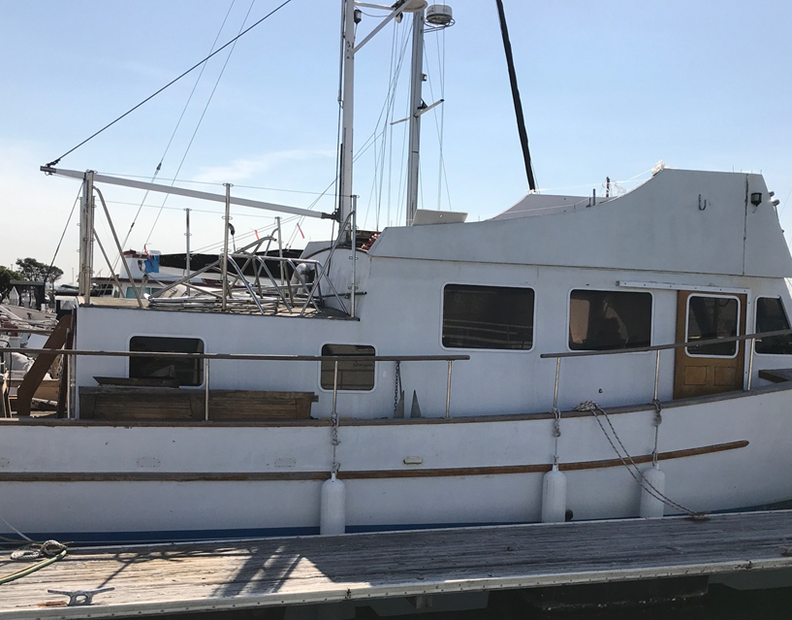
San Mateo County Harbor District Oyster Point Marina Lien Sale Wednesday, November 6th, 2019 @11:00 AM 95 Harbormaster Road South San Francisco, CA 94080 Pre Auction Walk through is at 10:00 AM day of Auction
2005 42 Foot Indigo
2005/42 Feet
$2,000 Cash/Cashier’s check deposit due to Auction
Bidding starts at $2,000
With three day vessel removal contingency
Complete conditions of sale available at Harbormasters office
No proxy buyers allowed.
Oyster Point Marina no longer accepts House Boats

