Slide 1
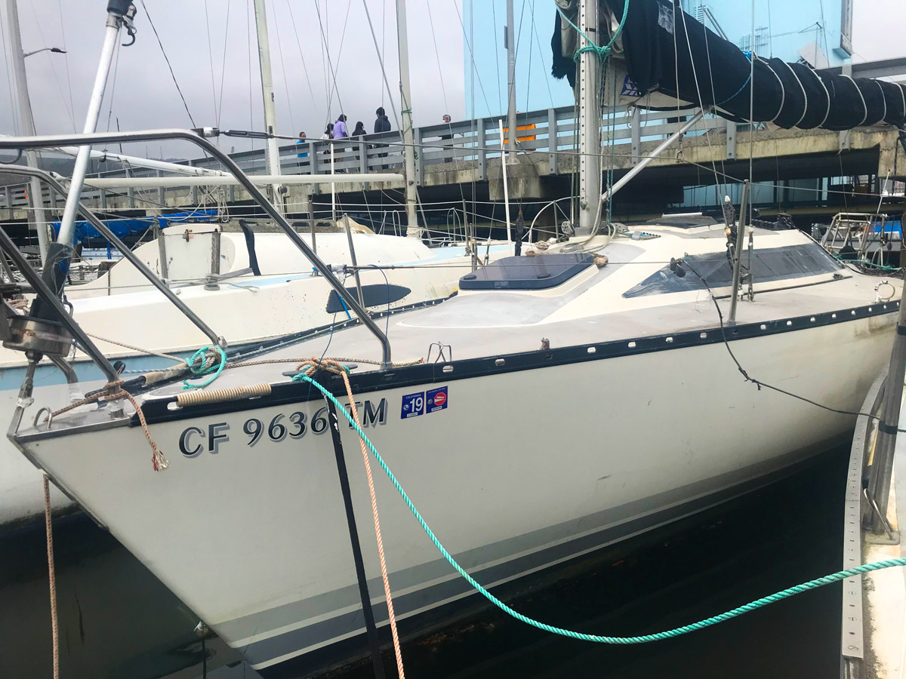
San Mateo County Harbor District Pillar Point Harbor Lien Sale Wednesday, August 12th, 2020 @11:00 AM One Johnson Pier, Half Moon Bay, CA 94019 Pre Auction Walk through is at 10:00 AM day of Auction -- All Interested parties will only be allowed to view the vessel for 10 minutes. Only one person allowed on the boat at a time. -- Social distancing is mandatory and face coverings must be worn
1985, 30ft
2005/42 Feet
$2,000 Cash/Cashier’s check deposit due to Auction
Bidding starts at $5,700.00
With three day vessel removal contingency
Complete conditions of sale available at Harbormasters office
No proxy buyers allowed.

