Slide 1
San Mateo County Harbor District
Board Dynamics Workshop
Brent H. Ives, Principal
BHI Management Consulting
February 11, 2015

Slide 2
This Workshop
• I will try to lay it as straight for you as possible
• Look at Board dynamics now
• Discuss how to plot a pathway for a stable future
• Potentially make some commitments
• Review some recommendations …

Slide 3
Where You Are
Today’s venue creates the controlled time for you to vent
It creates the moment for you to better understand one another
You must be open and respectful
Get anything that may be bothering you on the table
This time creates that opportunity
Understand that you are all in this together, tough lessons of the past can instruct us as we look into the future.
Its time to talk about how you will and won’t work together for the good of this Mission …
Notes:
WE PRESUME THAT YOUR OVERARCHING GOAL IS A HIGHLY EFFICIENT DELIVERY OF PUBLIC SERVICES AS EXPRESSED BY YOUR MISSION.

Slide 4
Board History
History and path the Board has taken cannot be ignored
The past has left baggage
The past, if it goes too far, is often difficult to overcome
The current Board has taken some turns that could result in trouble
You all are making some assumptions about one another
But, this Board is not the last Board
This Board is the only body that can chart a positive future for the District
You individually have choices to make…

Slide 5
The Evolution Steps of Board Dynamics
Different ideas get shared from the podium,
Boards take exception to approach and implication,
New ideas, perspective gets elected,
Board fractures,
Disrespect, names, poor communications, distrust, inuendo, misunderstandings, defensiveness…
People notice,
Board changes more,
Aggressive changes, aggressive schedule
Board has decisions to make…

Slide 6
Impacts
This has become a community concern
Lots of baggage
Lots of oversight
Effects on staff
Effects on recruitment
Overall efficiency can and will drop if you cannot work it out
It will take you all to agree on some things…

Slide 7
District Situational Dynamics
Board change, dynamics changed
New Board members
GM retired
Interim GM, diminished staff capacity
New Board Chair
Agenda overload
New committees
Pressure from Grand Jury, LAFCO, etc. …

Slide 8
Resultant Board Dynamics
There is some disrespect
There is distrust
History and baggage
There is effort to make changes on an aggressive schedule
There is some stress and resistance
“Gottcha” mentality and practice
There is hope however!! …

Slide 9
Points of Agreement
You all have told me you want what’s best for the District.
You all have told me you do not want the District to be dissolved.
I’ve recently seen you come together on an agreed remedy for workload remedy. THESE ARE HUGELY IMPORTANT AGREEMENTS
Its critical that this Board finds a way to continue to move the agency forward, and not let it slip into dysfunction!! …

Slide 10
SMCHD Board “An Overview of Service”
When a man (or woman) assumes a public trust, he should consider himself as public property.
- Thomas Jefferson

Slide 11
SMCHD Board “An Overview of Service”
• You do not need to “like” one another, but… you do need to work together
• There is precedence for working together , even when fundamentally different
- Founders of the country
- Roosevelt, Churchill, Stalin
- Clinton/Bush
• These all rose to the greater need
• You can too! In fact…

Slide 12
Inputs (Public/Interviews)
•• Board doesn’t listen
Board members are disrespectful
Board members need to learn how to treat one another
Board members need to learn how to treat staff
• Board must get its act together
•• Board has the opportunity to make things better
• Board is likely to mess this up
• Board needs to stabilize things now, make some changes but make them in due course …

Slide 13
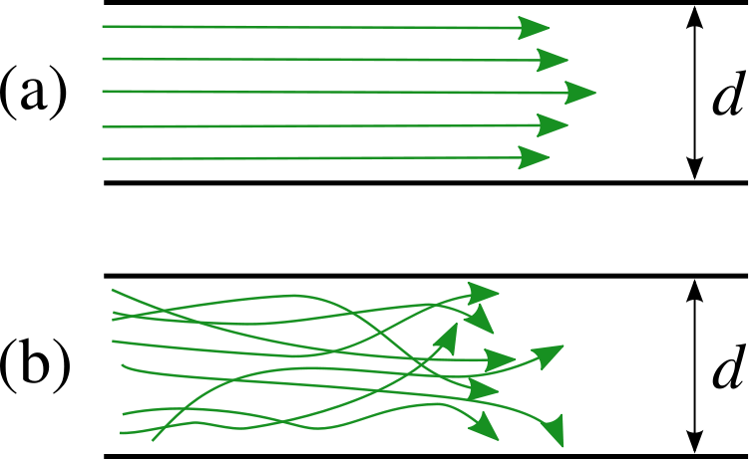
SMCHD Board Working together to put Mission First
Laminar flow
means more
Output -
EFFICIENCY
Turbulent flow
means less output,
chaos and
INEFFICIENCY

Slide 14
SMCHD Board “Poor motivations in Public Agencies”
• Focus on some other cause than the Mission
• Focus on ONLY a single agenda or cause
• Reluctance to buy-into the public process
• Role misunderstanding
• Distrust
• Lack of Board direction…

Slide 15
Your Dynamics
• No one benefits from disrespect
• The public gets a raw deal if their representatives lose their bearings
• Your intentions may be white as snow, but if this appears dysfunctional….maybe it is dysfunctional
• I see the situation before you as an opportunity
• What to commit to??…THE MISSION …

Slide 16
Your Opportunity
• This is not a fresh start, but…
• This is a turning-point!
• You as a Board can begin tonight making the future easy or hard
• The public and others are watching
• So what to do? …

Slide 17
Its time to hit the Restart button for SMCHD!!
Notes:
As Board members, we come and we go, but this Mission endures!

Slide 18
Your Opportunity
#1 – Bury the hatchet
#2 - Commit to the Mission only
#3 – Adopt some Board Norms …

Slide 19
In One Year?
WHAT WOULD YOU LIKE TO BE ABLE TO SAY
ABOUT YOUR DISTRICT COME
FEBRUARY 11, 2016?

Slide 20
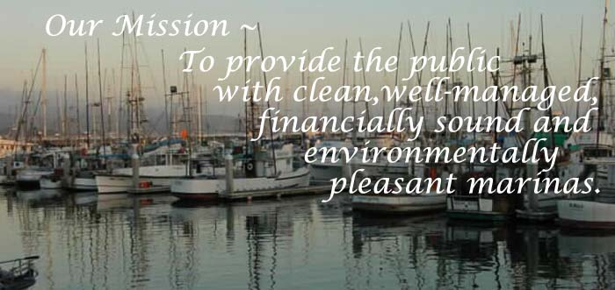
This Workshop
Commit to concentrating on this Mission as your driving
motivator as Commissioner

Slide 21
SMCHD Board “Commission Norms”
• This Commission should make some agreements among yourselves
• This is needed to assure that you can optimize your path forward (your words)
• Your norms should deal with:
- how you interact with one another
- how you communicate with each other and staff
- how you make decisions
- how you do your work …
Notes:
A leadership team…

Slide 22
Thoughts on Commission Norms 2015
• We respect the public process, thus one another
• When we disagree, we do so respectfully, all viewpoints are valued
• We give each other the benefit of any doubt
• We conduct the public’s business in a professional way
• We are committed to the Mission only
• We respect staff on a professional basis
• We both trust and verify our executive and staff as a whole Commission
• We are free to be open and honest, not disrespectful in our communications
• We formally communicate as a decision making body, not individuals
• We stay focused on the higher plain of Mission, Vision, Results and Achievements
Notes:
A leadership team…

Slide 23
SMCHD Commission Moving Forward
Move on…
All-in!?
Identify and get beyond dysfunctional differences
Identify this Board’s work norms
Work on the future together …

Slide 24
SMCHD Board Recommendations
Establish and Practice Board Norms
Clarity and agreement on how agendas will be developed
Clarify committees and how they do their work prior to their start…slow down and do it right
Review, discuss and update Commissioner’s Handbook
Consider conducting a Board/Staff Relations workshop…

Slide 25
Effects on Recruiting
Candidates are always assessing their next right career move
The reputation precedes you
Top talent will need to see real efforts to stablize
Your recruiter needs to be able to reference evidence of sincere effort on better Board dynamics
This will is the long game
Your new GM will need to see and feel things better

